Slide 1
Build A Word Press Application

Slide 2
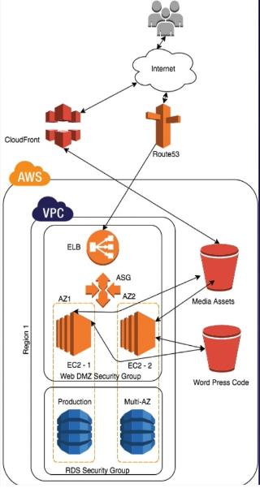
Amazon Word-press

Slide 3






Images
CloudFront
wp-content/
WordPress
Media S3 bucket
Backup to S3
/var/www/html
Code S3 bucket
New Ec2 Machine
RDS

Slide 4
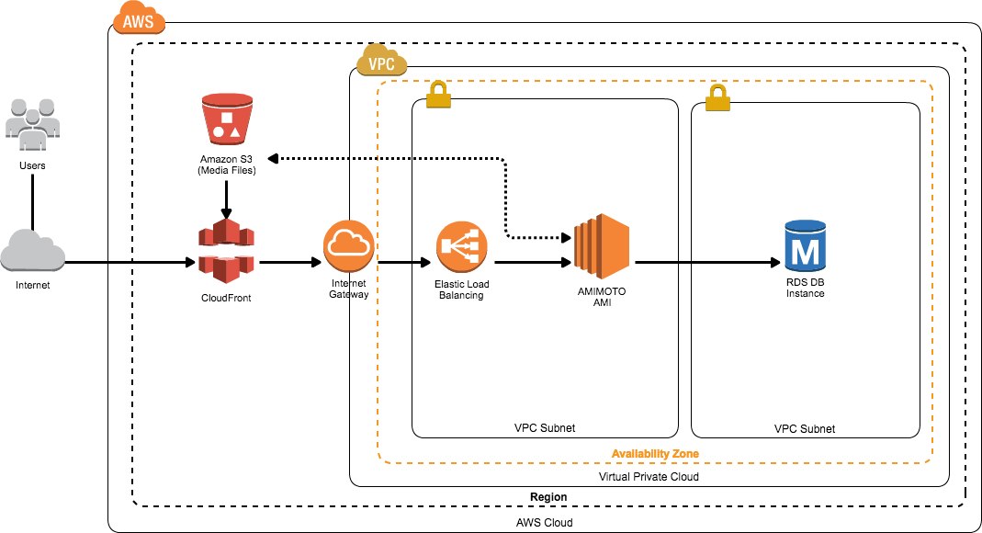
Amazon Word-press

Slide 5
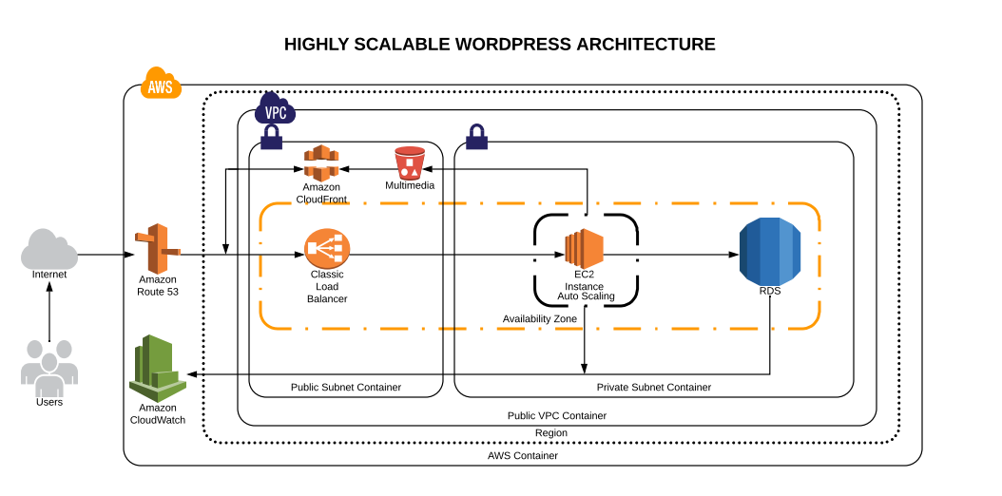
Amazon Word-press

Slide 6




Amazon Word-press
http://parooj.in
Reader Node
User/Consumer
Writer Node
http://writer.parooj.in
Content Writer
Sync Up every
1-minute
192.168.1.0
Code S3 bucket

Slide 7
Thank you

